Slide 1

Business Process and UML
Rr Octanty Mulianingtyas, S.Kom, M.Sc

Slide 2
UML
The Unified Modeling Language (UML) is a standard language for writing
software blueprints that premiered with version 1.1 in 1997
UML establishes a collection of graphical symbols as well as semantics to support and define these symbols. This collection can be broken
down into three kinds of building blocks:
-things
-relationships
-diagrams
There are nine different kinds of diagrams in UML: class, object, use case, sequence, collaboration, state chart, activity, component, and deployment

Slide 3
UML
Many of the concepts in UML previously existed in object-oriented programming. One part of object oriented programming is object-oriented analysis.
Object-oriented analysis is a method of analysis that examines requirements from the perspective of the classes and objects found in the vocabulary of the problem domain.
An object is something you can do things to.
A class is a set of objects that share a common structure and a common behavior.
The significance of object-oriented analysis is to build objects that directly represent things in the physical world.

Slide 4
Business Process Modelling
A model is a representation of a set of components of a process, system, or
subject area.
A business process is a set of activities that takes an object as an input and adds value to it in order to meet the requirements
A business process model is therefore a set of components that shows a set of activities. The purpose of creating a business process model is to better understand, analyze, improve, or replace a business process.
Developing models is one of the first steps in business process re-engineering.

Slide 5
Business Process Modelling
There are a large number of established techniques that support business process modeling. These techniques include Process Mapping, Simulation, Role Activity Diagrams, Integration Definition for Function Modeling (IDEF), Fishbone Diagrams, and Flowcharting, as well as many others.

Slide 6
IDEF0 Models
One way to gain a better understanding of how UML can be used to capture
business processes is to first consider notations that existed before UML, such as IDEF.
IDEF models were most popular in government information technology projects in the 1980's (Barrett). IDEF is a set of standards developed by the United States Air Force Program for Integrated Computer Aided Manufacturing (ICAM) in an effort to increase manufacturing productivity. IDEF0 models are a way to capture a static view of a process or relationship (IDEF Home Page).
The IDEF0 standard release in 1981 is designed to represents functions of a manufacturing system. The modeling portion of IDEF0 uses Input Control Output Mechanisms (ICOMs). The basic semantics for ICOMs are boxes and lines, sometimes called arrows

Slide 7
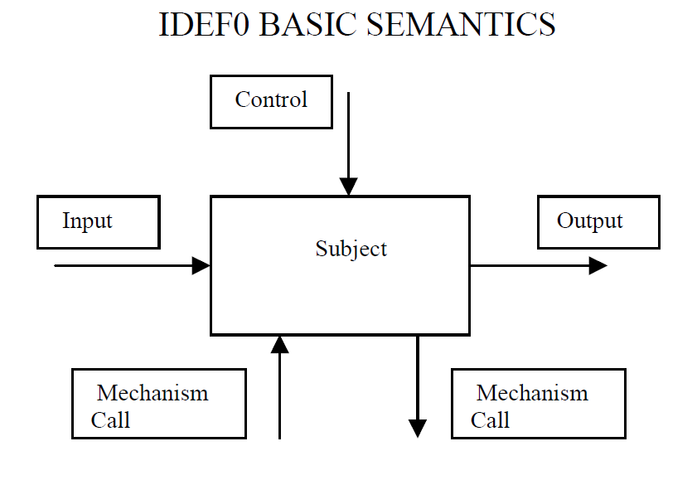
IDEF0 Models
Boxes are named with a verb phrase and represent activities, actions, tasks, or
other action-oriented parts of systems. Lines are named with a noun phrase and can be
inputs, controls, outputs, mechanisms, or calls.

Slide 8
Difference IDEF0 and UML
UML diagrams do not have notational constructs that are as restrictive as some of the constructs that apply to IDEF0.
For example there are only four kinds of arrows, input, output, control, and
mechanism arrows in IDEF0.
In contrast, the arrow counterpart in UML, a message, has no corresponding limitations.

Slide 9
UML is an excellent choice for business process
1. Companies can train employees in the UML and then task the employees to work on software projects, quality improvement projects, technical documentation projects, or any activity that needs a reliable technique to capture information.
2. From a technical perspective, UML is a superior choice for modeling all kinds of information. It can be used to capture complex information in its very expressive notation, or it can be used to display a limited set of simple concepts in a plain format that is easy for many inexperienced individuals to understand.

Slide 10
UML is an excellent choice for business process
3. From a business perspective, UML provides a cost-effective way to rapidly model processes.
4. From a user perspective, UML diagrams are easy to comprehend after an appropriate level of training. Companies that are looking for an inexpensive way to quickly capture and present information could reap great benefits by incorporating the UML to fulfill this need.

Slide 11
Infomarket.com
Infomarket.com is a fictional company based upon genuine business plans of
actual companies. Infomarket.com is an internet company provides an electronic
storefront for buying and selling unique research reports. There are two primary
customers: buyers and sellers. Buyers are consumers who purchase the reports and
sellers are the report authors.
The Infomarket.com Project Manager is a fictional character who will serve as the
subject matter expert who will review all Infomarket.com diagrams. The Infomarket.com. Project Manager has received an appropriate level of training in order to understand the diagrams, including parts of the diagrams that are not explained.

Slide 12
Use case
Name: Register Account
Purpose: Define the steps that a seller must follow in order for the seller to register with Infomarket.com so that they are permitted to sell reports on the Infomarket.com
electronic store.
Actors: Seller
Preconditions: The seller understands the business proposition that Infomarket.com
offers. The seller understands their responsibilities, and desires to register account
information at Infomarket.com.

Slide 13
Use case (cont)
Main Flow:
1. Register Account begins when the seller finds location on website that allows them to register account information.
2. The seller reads the steps necessary to complete registration process.
3. The seller inputs all required personal data.
4. Register Account ends when the seller replies to an email confirmation of receipt of
their account information.
Alternate Flows: None
Postconditions: The seller has completed all the necessary steps in order to be permitted
to sell material on Infomarket.com. The seller has received confirmation that the
information they submitted has been received by Infomarket.com.

Slide 14
Use case (cont)
Main Flow:
1. Register Account begins when the seller finds location on website that allows them to register account information.
2. The seller reads the steps necessary to complete registration process.
3. The seller inputs all required personal data.
4. Register Account ends when the seller replies to an email confirmation of receipt of
their account information.
Alternate Flows: None
Postconditions: The seller has completed all the necessary steps in order to be permitted
to sell material on Infomarket.com. The seller has received confirmation that the
information they submitted has been received by Infomarket.com.

Slide 15
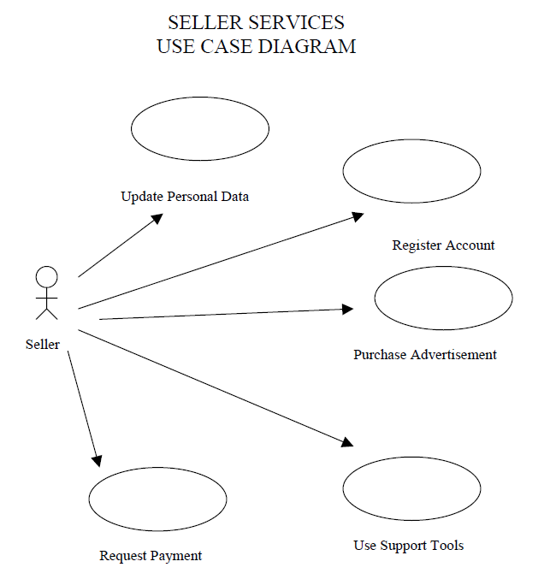
Use case (cont)

Slide 16
HIGH LEVEL PROCESSES WITH UML PACKAGES
UML provides a way to prevent confusion by organizing UML elements,
including use cases, with packages. A package is a general-purpose mechanism for organizing elements into groups.
Packages can be used to organize any UML element. Packages can then be
placed on a variety of UML diagrams, including use case diagrams. In fact, packages can be thought of as a fancy name for a file folder.

Slide 17
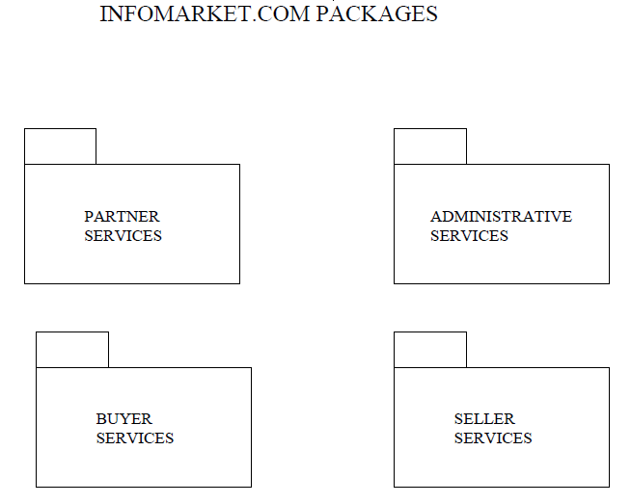
HIGH LEVEL PROCESSES WITH UML PACKAGES
This image shows a set of packages that represent the high level business processes of Infomarket.com. Each package contains a group use cases that are logically related.
For example the Seller Services package includes Update Personal Data, Request Payment, Use Support Tools, Purchase Advertisement, Register Account.
All of these use cases support or define some kind of seller services.

Slide 18
SEQUENCE DIAGRAMS VERSUS ACTIVITY DIAGRAMS
There are several ways to capture detailed business process information that
provide more information in order to supplement use cases. Two of the possibilities
within UML are sequence diagrams and activity diagrams.
Sequence diagrams are a kind of an interaction diagram that emphasize the time ordering of messages. A message is a specification of a communication between objects that conveys information with the expectation that activity will ensue
Sequence Diagram | Activity Diagram
A diagram that shows an interaction, consisting of a set of objects and their relationships, including messages that may be dispatched among them. | Activity diagrams show the flow from activity to activity

Slide 19
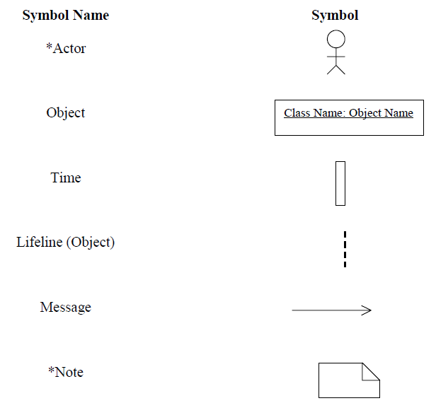
Sequence Diagram Symbol

Slide 20
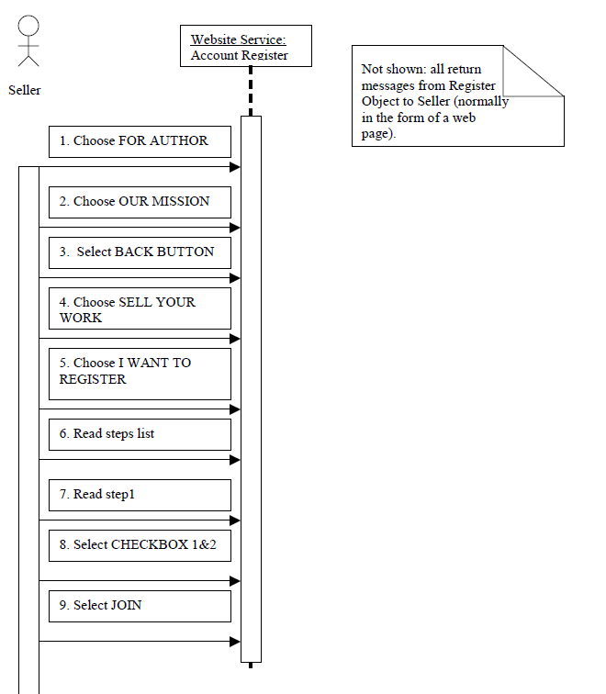
Register Account Sequence Diagram

Slide 21
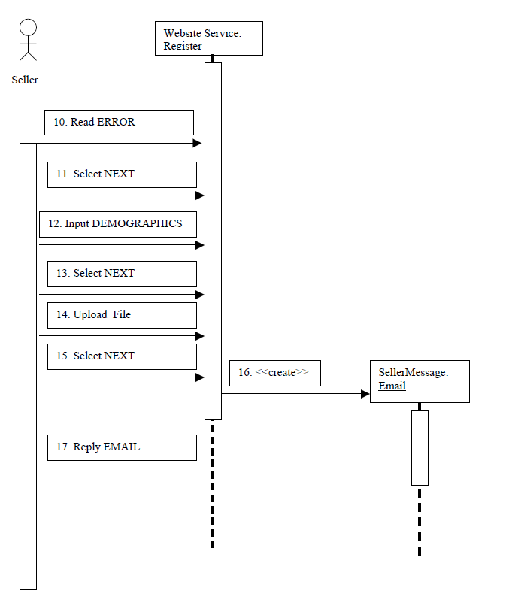
Register Account Sequence Diagram

Slide 22
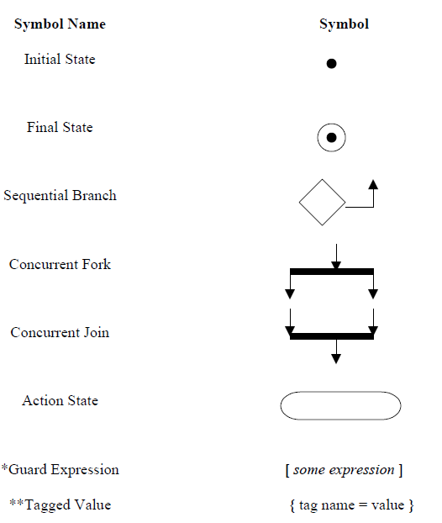
Activity Diagram Symbols

Slide 23
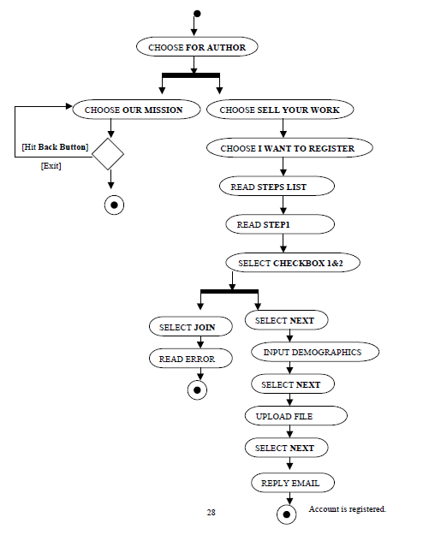
Activity Diagram Register Account

Slide 24
Resources
Dewalt, Craig. 1999. Business Process Modeling With UML. Johns Hopkins University

